Slide 1
Multiscale Modeling of Materials
Siladitya Pal
Multi-scale Computational Mechanics Lab.
Mechanical and Industrial Engineering Department
Indian Institute of Technology Roorkee
Roorkee
Email id: spal.fme@iitr.ac.in

Slide 2
Course outline
Introduction to multiscale method
Analytical homogenization procedures
Continuous computational homogenization
Concurrent multiscale methods

Slide 3
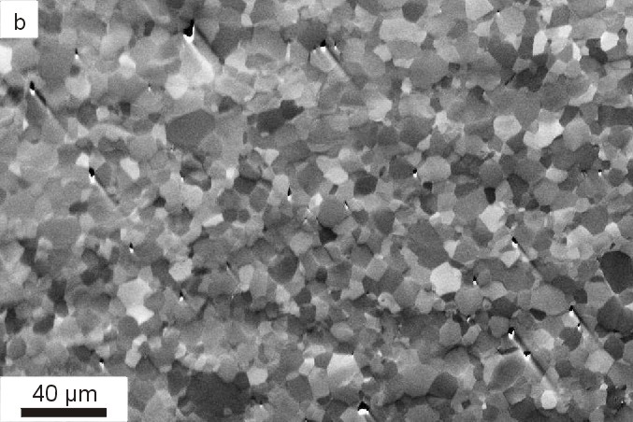
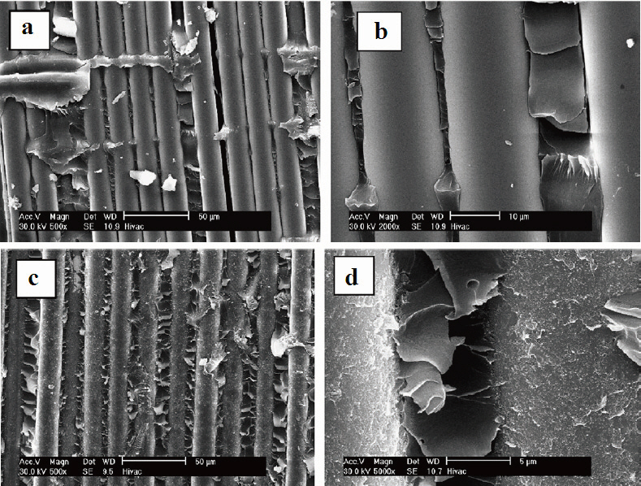
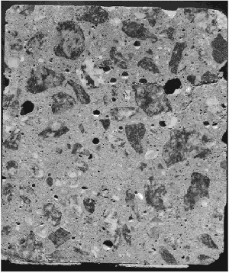
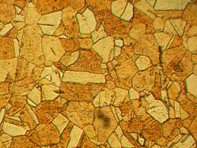
Heterogeneous materials
Many natural and engineering materials have heterogeneous structure
Often referred as Heterogeneous Materials/Composite Materials/Multi-phase materials
Rock
Concrete
Fiber Reinforced Polymer (FRP)
Brass
Heterogeneous structure at certain level of observation
Desirable as they can be tailor made to take advantage of particular constituent

Slide 4
Heterogeneous materials (contd)
Macroscopic mechanical behavior originates from mechanics of underlaying microstructure
Key mechanical performances of materials
Elastic moduli
Toughness
Ductility
Fracture resistance
Damping capacity
Hardening and softening behavior
Hardness
Microstructural parameters that influence the macroscopic behaviors
Shape
Size
Spatial arrangement
Volume fraction and properties of constituents of the microstructure

Slide 5
Need of predictive tool for complex materials
it is highly essential to unlock the structure-property-function relationship of heterogeneous materials
- to accurately describe the macroscopic behavior
- to provide an alternative to design new materials with desired macroscopic properties
Brute-force approaches practically not feasible due to prohibitive computational expenses
Several analytical/ numerical models (‘Multiscale model’) developed
- based on physics of microstructure
- able to predict macroscopic behavior in an efficient manner

Slide 6
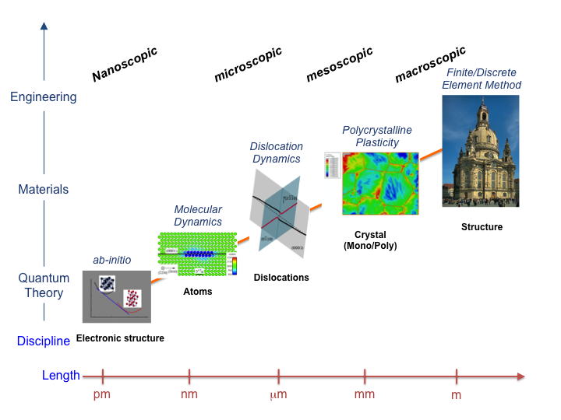
Multiscale method
Multiple length scale are resolved
Exchange of information across the length scale

Slide 7
Multiscale modeling framework
Homogenization:
-Scale are clearly separated
Concurrent method:
- Scales are coupled
Homogenization
heterogeneous material
homogeneous material

Slide 8
Homogenization method
Analytical/Mathematical homogenization
Numerical homogenization
Computational homogenization

Slide 9
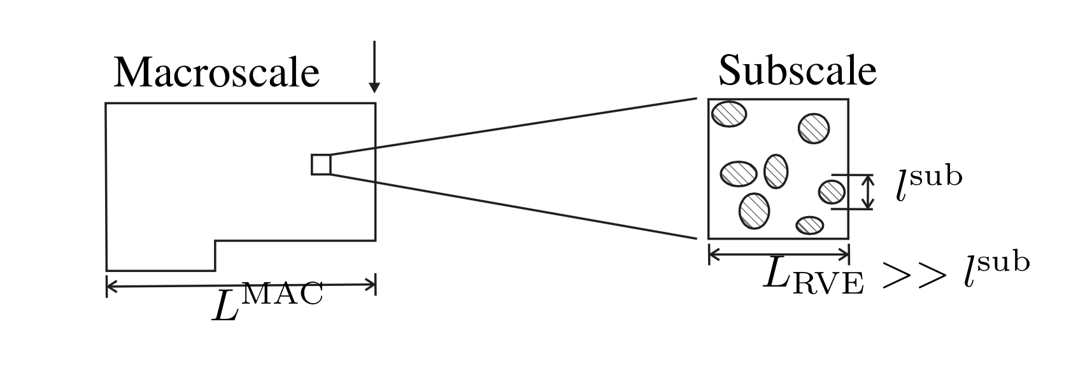
Representative Volume Element
Conditions on size of RVE
- Sufficiently small compared to the typical macroscale dimension of the structural component.
- Sufficiently large compared to the typical subscale dimension of micro-constituents, e.g. grains.
Notes:
Material volume that is large enough to yield accurate effective properties of the bulk material

Slide 10
Governing Equations and Boundary Conditions
Strain-Displacement relations
Stress-Strain relations
Balance of linear momentum
Balance of angular momentum
Balance of Energy

Slide 11
Governing equations at Macroscale and Microscale
Macro-scale
Micro-scale

Slide 12
Average strain and stress representation
Volume average on
Volume average of strain
Volume average of stress
Bridging between the Micro- and Macro-scale

Slide 13
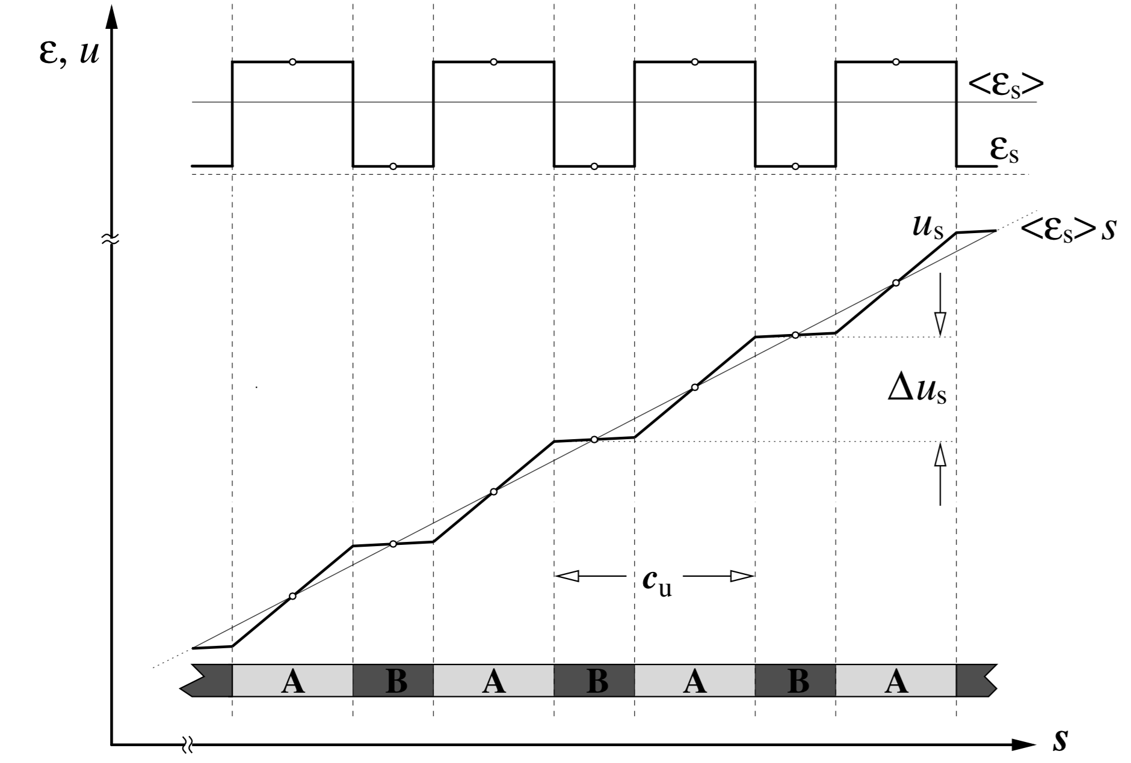
Average strain and strain fluctuation in one- dimensional composite

Slide 14
Effective properties –Linear Elasticity
Effective constitutive relation
Localization tensor
Effective constitutive relation using localization tensor
Knowledge of provides the solution for homogenization problem

Slide 15
Analytical homogenization
Based on ideal representation
Estimations or rigorous bounds for effective properties
Mean field methods for matrix-inclusions composites: Eshelby solution for dilute inclusions ESHELBY 1959, Mori-Tanaka-type approaches for non-dilute composite MORI, TANAKA 1973, HASHIN-SHTRIKMAN 1962
Classical bounds based on "rule of mixtures": Upper bound VOIGT 1887, TAYLOR 1938 (polycrystalline structure), CAUCHY-BORN 1890 (atomistic structure). Lower bound REUSS, HILL 1970, SACHS 1928 (polycrystalline structure)

Slide 16
Mean Field Approach
Micro-field within each constituent of an in homogeneous material are approximated by their phase average
Localization relation
Homogenization relation
Volume fraction
Notes:
For a two phase composite P=2
So we will have two locatization tensor for inclusions and matrix

Slide 17
Eshelby Tensor and Dilute Matrix-Inclusion Composite
Most mean field homogenization methods are based
on the work of Eshelby (1957)
Eshelby’s results shows that if an elastic homogeneous ellipsoidal inclusion
in an infinite matrix is subjected to homogeneous strain , the stress and
Strain state in the constrained inclusion are uniform
Eshelby tensor
Eshelby’s tensor depends only on the material properties of the matrix and on the aspect ratio of the inclusions
Expression for Eshelby’s tensor is available for several inclusion shapes and material symmetry

Slide 18
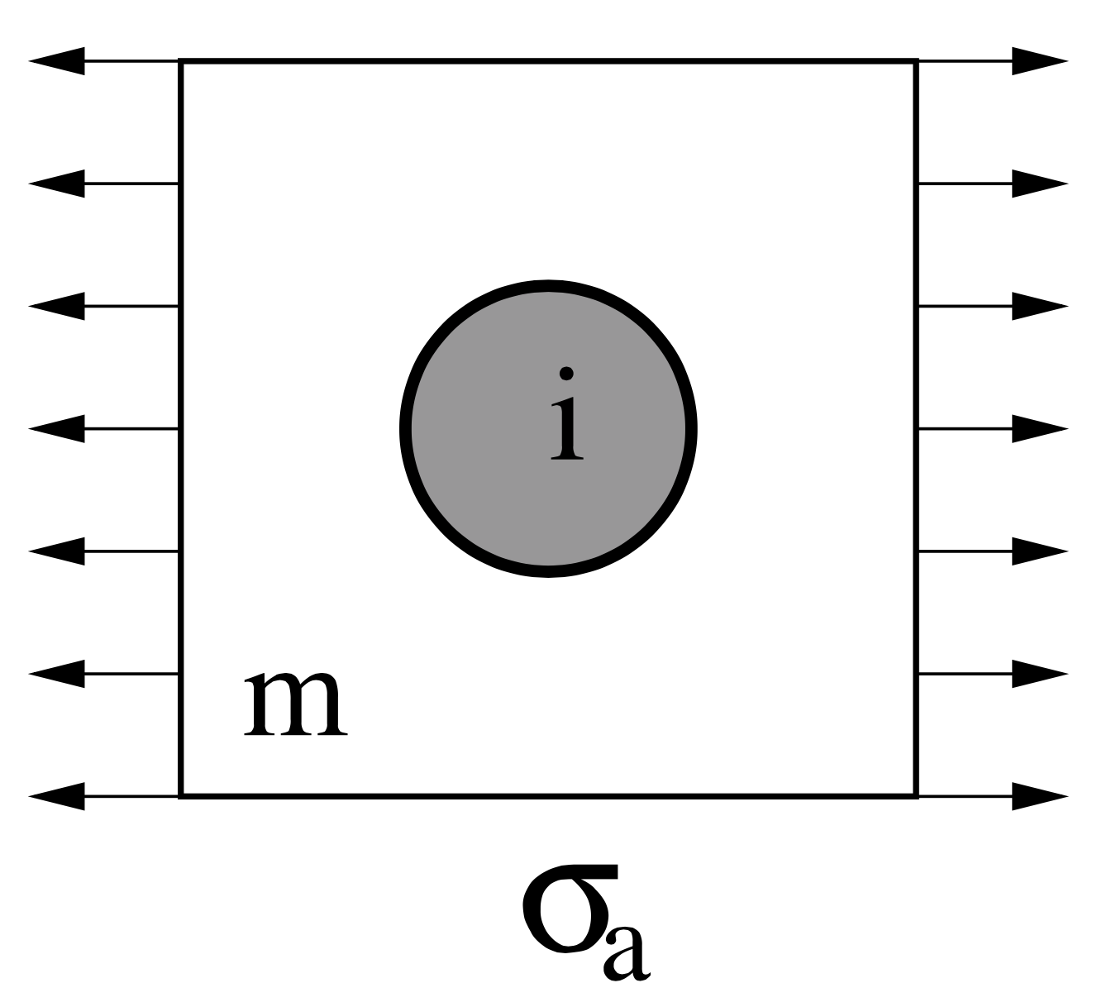
Eshleby Tensor and Dilute Matrix-Inclusion Composite
Assumptions for dilute composite
inhomogeneities are dilutely dispersed in the matrix
- no interaction with their neighbors
for a dilute composite
Concentration tensors are independent of the reinforcement volume fraction

Slide 19
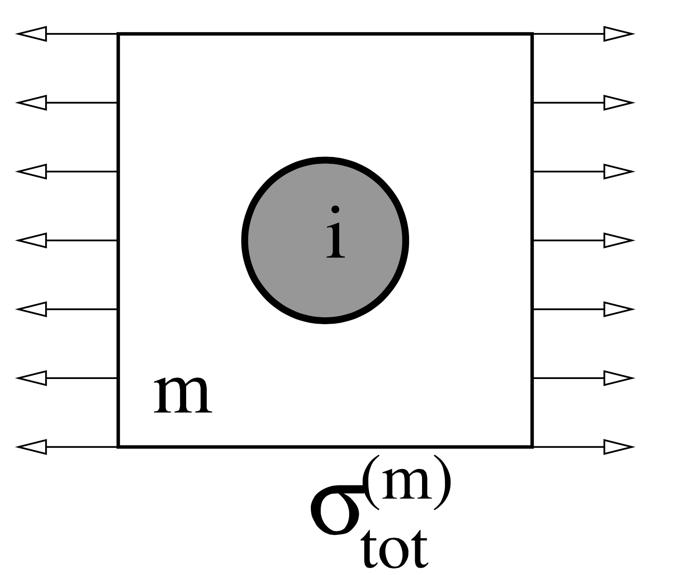
Mori-Tanaka Type estimates
Introduces collective interactions between inhomogeneities by approximating the stress acting on an inhomogeneity
viewed as perturbation stress caused by other inhomogeneities (image stress or background stress) superimposed on the far field stress
Inclusion fields phase average
Matrix fields phase average

Slide 20
Mori-Tanaka Type estimates …
Strain and Stress concentration tensor for inhomogeneity
Strain and Stress concentration tensor for Matrix

Slide 21
Mori-Tanaka Type estimates …
Macroscopic elasticity tensor
Special case: Macroscopic stiffness of Porous materials ( )
Can be implemented into computer program in a straight forward way
They are explicit algorithm
Requires matrix operations only (Matrix addition, multiplication and inversion)
Requires expressions for Eshelby tensor
Provides useful accuracy for most practically relevant composite

Slide 22
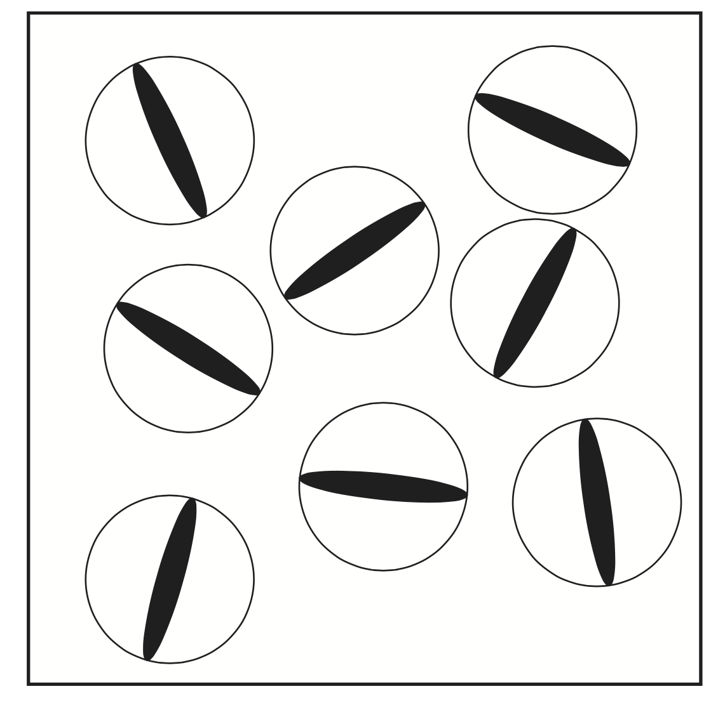
Ponte-Castaneda and Willis model
Refined mean field scheme for inhomogeneous material
Inclusion spatial arrangement is enforced using different shapes of safety cell enclosing the inclusion
Spatial correlation of arrangement is described by Eshelby tensor
Shapes of inhomogeneities via

Slide 23
Ponte-Castaneda and Willis model …
Strain concentration tensor for inhomogeneity
Macroscopic elasticity tensor

Slide 24
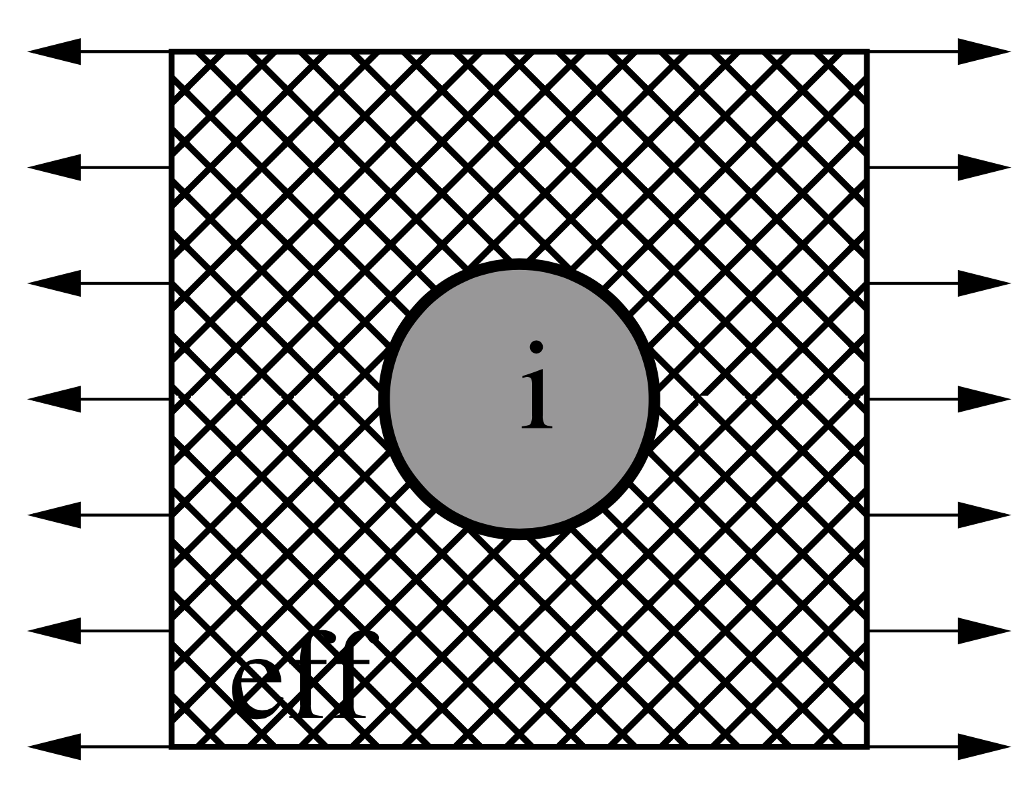
Classical Self Consistent Estimate
Based on treating all the phases as inhomogeneities immersed in an a priori unknown reference medium
Mean field approximation of stress and strain vanishes here
In contrast Mori-Tanaka method, no distinction is made matrix and inhomogeneity phases
System of implicit nonlinear equation for the unknown elastic tensor
Must be solve by self consistent iterative scheme
Eshelby tensor describes the response of an inhomogeneity embedded in the n-th iteration of the effective medium

Slide 25
Other Analytical Estimates for Elastic Composites and Bounding Methods
Hashin-Shtrikman Estimates
Generalized Self-Consistent Estimates
Bounding Methods
Hill Bounds
Hashin-Shtrikman –Type Bounds
A comprehensive overview of analytical homogenization method can be found in the textbook of Nemat-Nasser and Hori

Slide 26
Numerical Homogenization
Macroscopic canonical constitutive model is assumed
Based on parameters determined by fitting the data
Produced by FE computation of the microscopic sample
Detail microstructure is explicitly modeled
Often referred as unit cell method
Enable the development of micromechanically derive continuum damage and plastic model
Less attractive for nonlinear problems with evolving microstructure
Computationally attractive for large scale computation

Slide 27
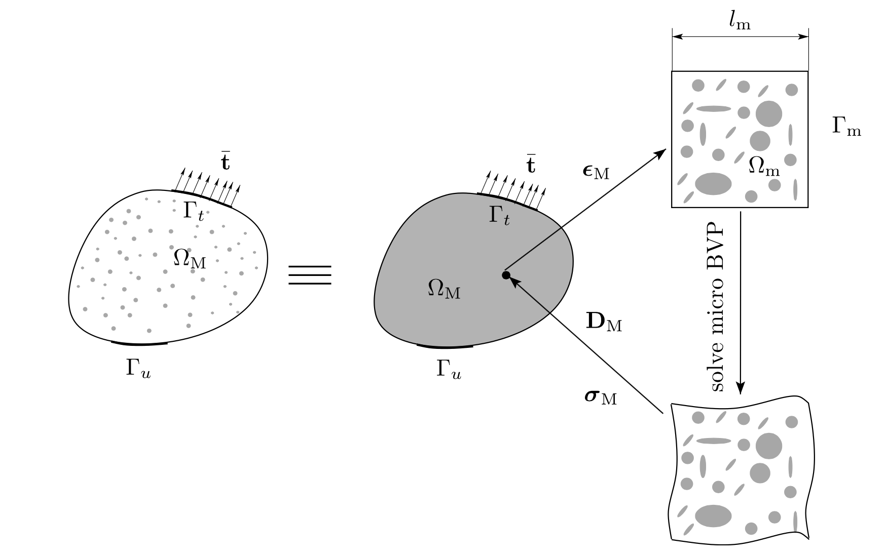
Continuous Computational Homogenization
-To define on the fly macroscopic stress-strain relation from a macroscopic point from a microscopic sample attached to this point
- also referred as “Multiscale Constitutive Modeling”
Finite element implementation of both scales known as FE² scheme

Slide 28
Procedure of the continuous CH scheme
Downscaling or macro-to-micro transition
- The macroscopic strain vector is transformed to the RVE as boundary condition
- Specific BCs must full fill the strain averaging theorem
Solution of BVP of the RVE (in short, the micro- BVP)
Upscaling or micro-to-macro transition
- Microscopic stresses are upscaled to macroscale as the macroscopic stress vector
Hill-Mandel principle is used
The macroscopic stiffness matrix is upscale to the macroscopic material tangent

Slide 29
Strain averaging theorem
The strain at any point in the macroscopic solid is defined as volume average of the microscopic strain over the RVE that is associated with that point
denotes the measure of the domain

Slide 30
Hill-Mandel macro-homogeneity principle
Macroscopic stress power must equal the
A specific boundary condition that fulfills strain averaging theorem in the above equation

Slide 31
Boundary Conditions
Choice of BC: An important aspect in RVE based homogenization
Imposed on the RVE boundary
Different BC affects the macroscopic constitutive response
Boundary Conditions commonly used in CH Scheme
Linear or Displacement boundary condition
Constant traction boundary condition
Periodic boundary condition

Slide 32
Evaluation of boundary conditions
Microscopic displacement is superposition of average field and fluctuating
field induced by the presence of heterogeneity
m : Microdomain
M: Macrodomain
Thus we have

Slide 33
Evaluation of boundary conditions
m : Microdomain
M: Macrodomain

Slide 34
Displacement boundary condition
Above condition is satisfied when
at the boundary
Boundary displacements generated by macroscale strain- Dirichlet BC

Slide 35
Periodic boundary condition
On
This condition states a non-trivial periodicity of superimposed fluctuation
on
Here the boundary is understood to be decomposed in to parts
With outward normal and and

Slide 36
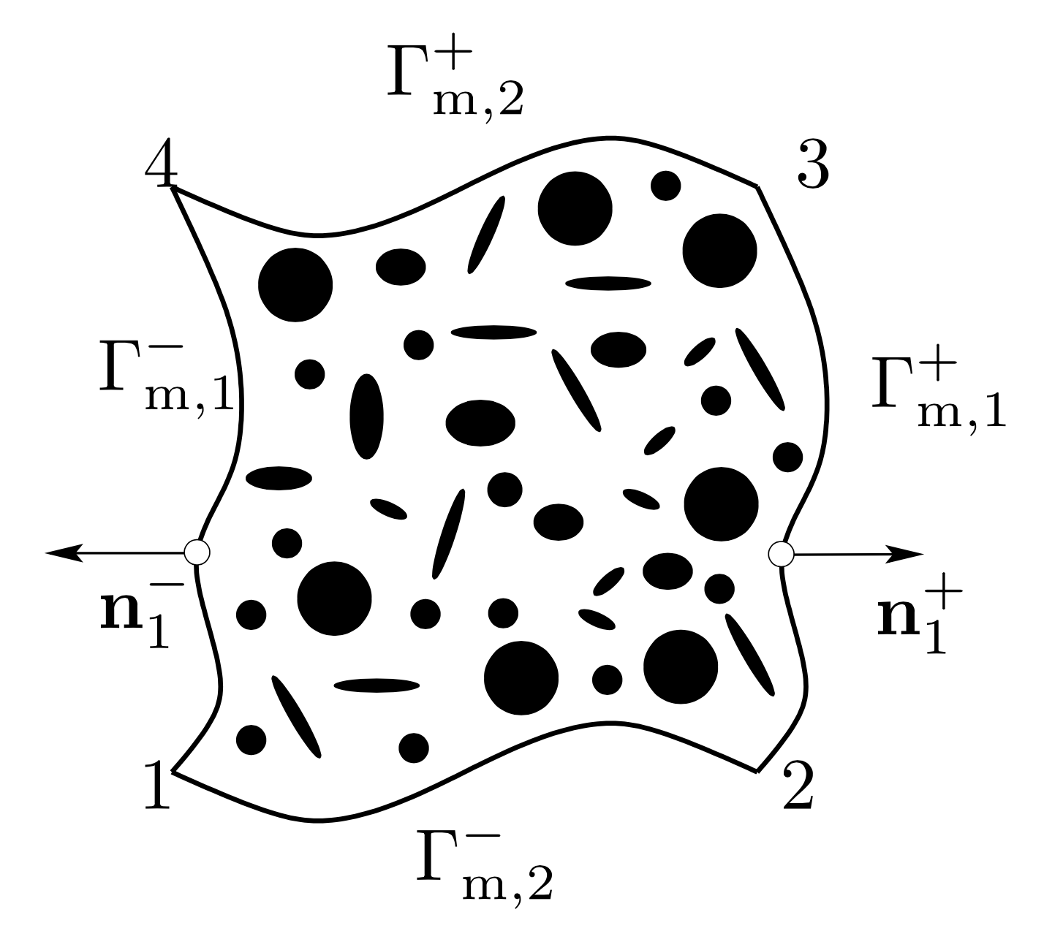
Periodic boundary condition …
4
3
1
2

Slide 37
Traction boundary condition
Stress-power difference becomes
on
satisfies Hill’s Mandel’s condition
Boundary traction generated by a macroscale stress –Neumann BC

Slide 38
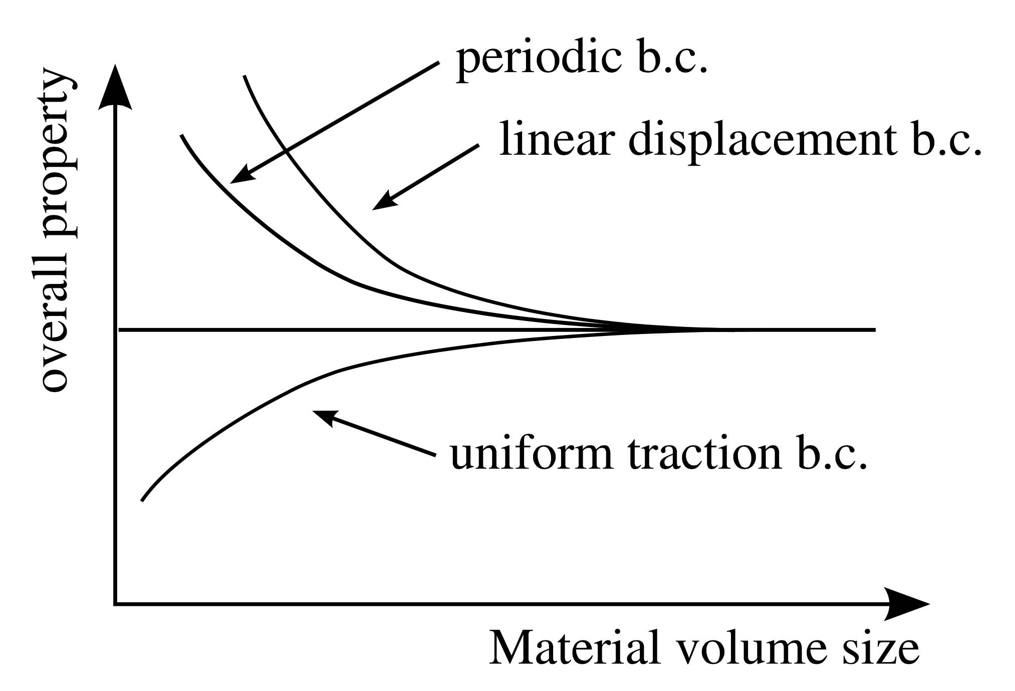
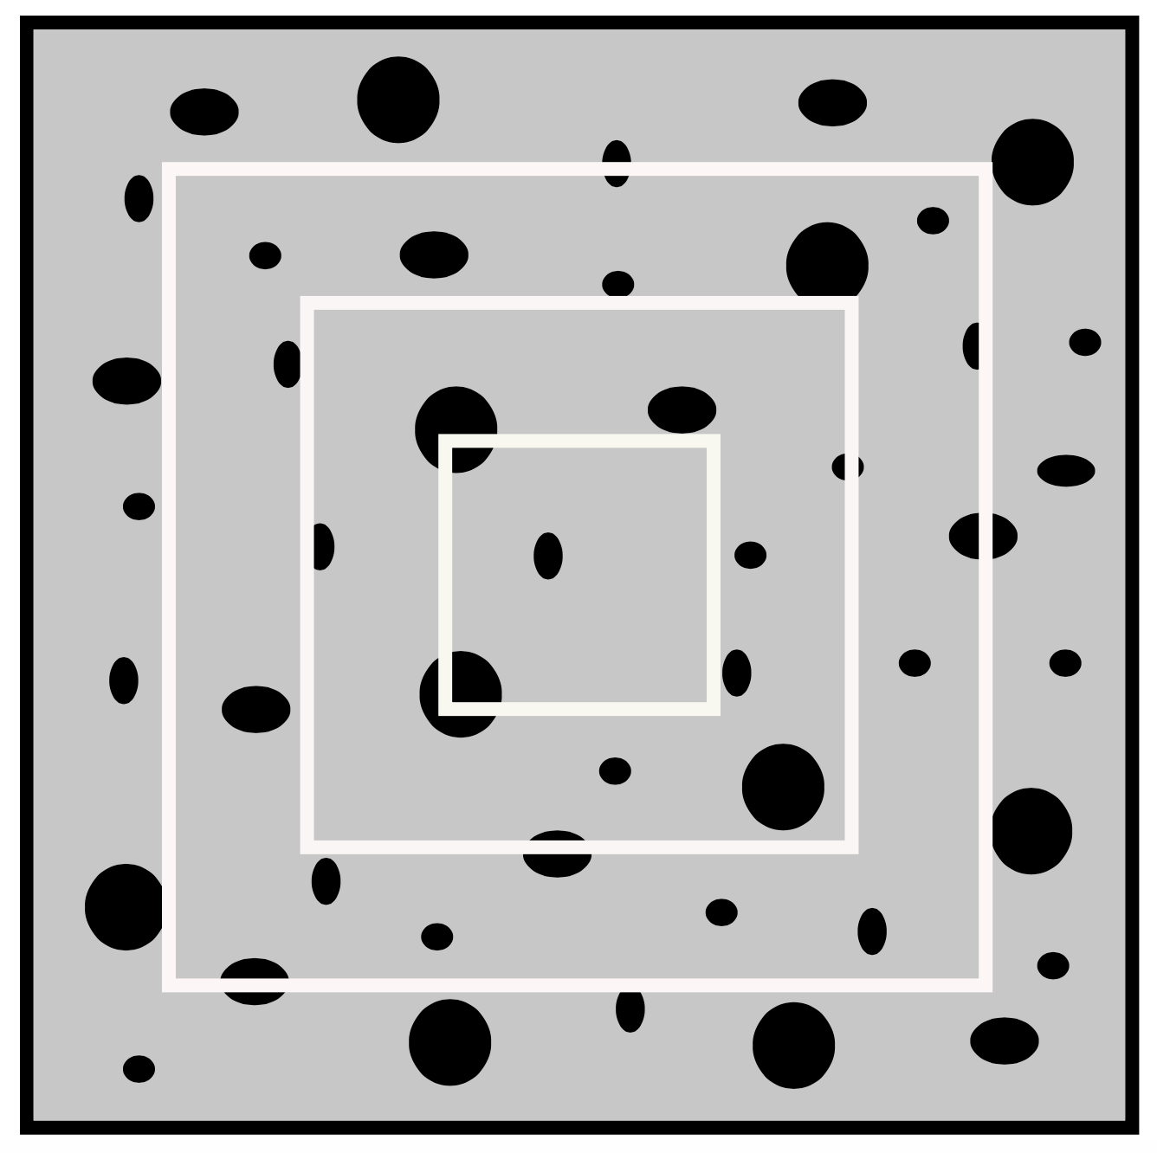
Convergence based on BCs

Slide 39
Reducing the Computational Cost
Parallel implementation of Two-Scale Finite Element (FE²)
Computational Homogenization models are suitable for parallel computation
RVE computations are independent of each other
Microscopic Computations are performed in parallel
Macroscopic computation is handled by a root (or master) processor

Slide 40
Limitation of Continuous Computational Homogenization for softening materials
Strain localization at RVE level leads macroscopic stress-strain to a strain softening equation
Macroscopic BVP becomes ill-posed (loss of ellipticity)
Numerical Solution becomes sensitive to macroscopic finite element discretization
Applicability of conventional CH theory for softening materials is questionable

Slide 41
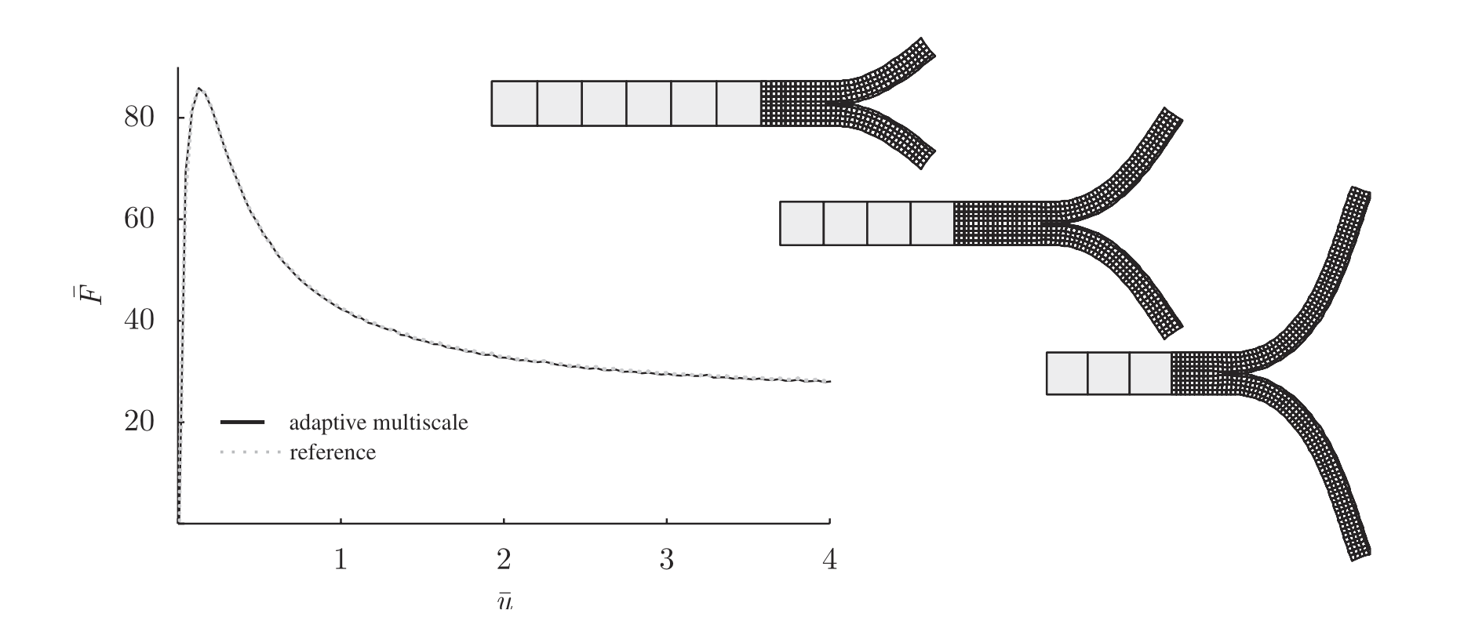
Concurrent Multiscale Model
Microstructural features are resolved directly on the microscopic model
Modeling challenges involved
(1) how to handle the coarse scale mesh and fine scale mesh
(2) efficient algorithms for adaptive addition of fine scale features to the coarse scale
J. Mergheim, IJNME 2009

Slide 42
Summary
Multiscale modeling frameworks are necessary to develop advanced materials understanding the mechanics and physics of their under-laying microstructure
Analytical homogenization procedures provide quick estimate of the material properties and also can be used in FE softwares
Continuous computational homogenization: a robust approach to solve the macroscale model explicitly accounting the RVEs on the fly when RVE length scale is very small
Continuous computational homogenization is computationally intensive however parallel implement can be performed
Concurrent multiscale model are used when microstructural features are comparable to macroscale dimension

Slide 43
Thank you

